Slide 1

File System API
Computer System Engineering, Fall 2019. (IPADS, SJTU)
OPEN, READ, WRITE, SEEK, CLOSE, ...
Yubin Xia

Slide 2
Review: File
File is a high-level version of the memory abstraction
Recall the difference between abstraction and virtualization
A file has two key properties
It is durable & has a name
Implements files using modules from hardware layer
Divide-and-conquer strategy
Makes use of several hidden layers of machine-oriented names (addresses), one on another, to implement files
Maps user-friendly names to these files
Notes:
Everything is a file:
same operations: open, read, write, ioctl
same naming scheme

Slide 3
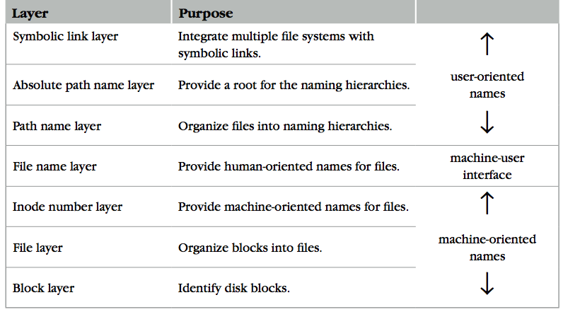
Review: The Naming Layers of the UNIX FS (v6)

Slide 4
Review Questions
Q: Is file name a part of a file? It's data or metadata?
Q: What is the actual content of a directory? Size?
Notes:
In inode file system, file name is no a part of a file (not even metadata, i.e., its inode).
From the inode layer's perspective, a directory is data.
From the file system's perspective, a directory is metadata.

Slide 5
Directly Dump a Directory
$ ls -ai temp
7536909 . 7530417 .. 7536939 a 7536940 b 7536941 c 7536942 d
$ echo “obase=16;7536909;7530417;7536939;7536940;7536941;7536942" | bc
73010D 72E7B1 73012B 73012C 73012D 73012E
$ sudo /sbin/debugfs /dev/sda1
debugfs 1.43.4 (31-Jan-2017)
debugfs: dump temp temp.out
debugfs: quit
$ xxd temp.out
0000000: 0d01 7300 0c00 0102 2e00 0000 b1e7 7200 ..s...........r.
0000010: 0c00 0202 2e2e 0000 2b01 7300 0c00 0101 ........+.s.....
0000020: 6100 0000 2c01 7300 0c00 0101 6200 0000 a...,.s.....b...
0000030: 2d01 7300 0c00 0101 6300 0000 2e01 7300 -.s.....c.....s.
0000040: c40f 0101 6400 0000 0000 0000 0000 0000 ....d...........
0000050: ...

Slide 6
Directly Dump a Directory
struct ext4_dir_entry {
uint32_t inode_number;
uint16_t dir_entry_length;
uint8_t file_name_length;
uint8_t file_type;
char name[EXT4_NAME_LEN];
}
0d01 7300 0c00 0102 2e00 0000
b1e7 7200 0c00 0202 2e2e 0000
2b01 7300 0c00 0101 6100 0000
2c01 7300 0c00 0101 6200 0000
2d01 7300 0c00 0101 6300 0000
2e01 7300 c40f 0101 6400 0000
File Type
0x0: Unknown
0x1: Regular file
0x2: Directory
0x3: Character device file
0x4: Block device file
0x5: FIFO
0x6: Socket
0x7: Symbolic link
0d01 7300 0c00 0102 2e00 0000
0d01 7300: inode number
0c00: entry length is 12 bytes
01: file name length is 1 byte
01: file type is regular file
2e00 0000: file name (2e -> ".")

Slide 7
Two Types of Links (Synonyms)
Add link "assignment" to "Mail/new-assignment"
Hard link
No new file is created
Just add a binding between a string and an existing inode
Target inode reference count is increased
If target file is deleted, the link is still valid
Soft link
A new file is created, the data is the string "Mail/new-assignment"
Target inode reference count is not increased
If target file is deleted, the link is not valid
Soft link can create cycle by SYMLINK("a", "a")
Notes:
Here comes a demo~

Slide 8
Directly Dump a Symbolic Link
$ ln -s "/tmp/abc" s-link
$ ls –l s-link
7536945 lrwxrwxrwx 1 xiayubin 8 Sep 20 08:01 s-link -> /tmp/abc
$ readlink s-link
/tmp/abc
$ cat s-link
cat: slink: No such file or directory
$ echo "hello, world" > /tmp/abc
$ cat s-link
hello, world
What does "8" means?
File size

Slide 9
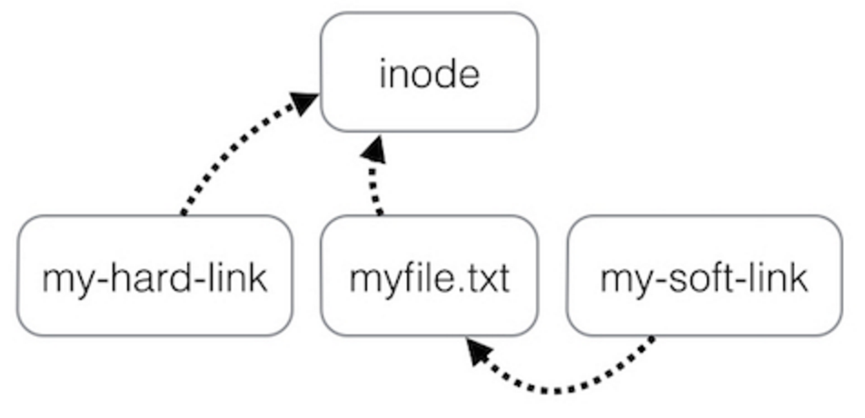
Two Types of Links (Synonyms)
By inode number
By inode number
By file name

Slide 10
Sidebar: Notice the Context Change
Another interesting behavior of soft link
Current directory is "/Scholarly/programs/www"
This directory contains a soft link
"CSE-web" -> "Scholarly/programs/www"
Run following commands
cd CSE-web
cd ..
What is the current directory? Why?
".." is resolved in a new default context: by bash, not by file system

Slide 11
Sidebar: Notice the Context Change
The bash tries to be "human-friendly"
When you cd /into/a/symlink/, the shell remembers the old location (in $OLDPWD) and will use that directory when you cd .. under the assumption that you want to return to the directory you were just in
If you want to use the real .., then you must also use "cd –P .." The -P option says to use the physical directory structure instead of following symbolic links (see also the -P option to the set builtin command); the -L option forces symbolic links to be followed.
$ cd
$ cd a/b/symlink
$ cd -P ..
$ pwd -P
/home/sarnold
$

Slide 12
Summary of File System 7 Layers
File name is not part of a file (neither data nor metadata!)
Name is not a part of an inode
Name is actually the data of a directory
An inode can have several names (hard LINK)
Hard links are equal
If a file has two names, both are links (instead of a link and a name)
Directory size is small
Only mapping from name to inode number
"Folder" is somewhat misleading
Notes:
Vnode is in Memory-only
It hides different FS implementation from upper layers
Vnode only exists when a file is open

Slide 13
Review: FAT File System
File allocation table (FAT)
Organize files as linked lists
No inode
File metadata: name & size
Metadata are saved in dirs
Root dir at sector 0
Link? Permission?

Slide 14
File system API

Slide 15
Implementing the File System API
API
CHDIR, MKDIR
CREAT, LINK, UNLINK, RENAME
SYMLINK
MOUNT, UNMOUNT
OPEN, READ, WRITE, CLOSE
SYNC
Implemented as system calls to user applications
Kernel has many sets of function pointers implementing the API
Each set is specific to a FS (chose at mount point)
Notes:
What is the difference between FILE* and fd? Fopen and open?

Slide 16
Sidebar: open() vs. fopen()
Difference between open() and fopen()?
open() returns an fd; fopen() return a FILE*
open() is a system call of OS; fopen() is an API of libc
Questions
Which one can be used on both Windows and Linux?
Which one has better performance?
fopen() provides you with buffering IO that may turn out to be a lot faster than what you're doing with open()

Slide 17
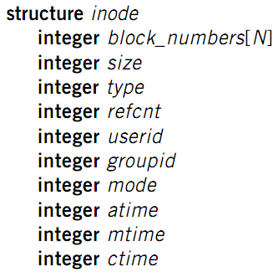
File Meta-data
Owner ID
User ID and group ID that own this inode (can be changed by chown)
Types of permission
Owner, group, other
Read, write, execute
Time stamps
Last access (by READ)
Last modification (by WRITE)
Last change of inode (by LINK)
Notes:
There are three more mode bits: setuid, setgid, stick_bit

Slide 18
OPEN a File
Check user's permission
Update last access time
Return a short name for a file
File descriptor (fd)
fd is used by READ, WRITE, CLOSE, etc.

Slide 19
File Descriptor
Each process starts with three open files
Standard in: fd = 0, standard out: fd = 1, standard error: fd = 2
Can also use fd to name opened devices
Keyboard, display, etc.
Allow a designer not to worry about input/output
Just read from fd 0 and write to fd 1
Each process has its own fd name space
Notes:
What is the different between fd and inode?
More details on device as a file

Slide 20
Why File Descriptor?
Other options
Option-1: OS returns a in-kernel inode pointer
Option-2: OS returns all the block numbers of the file
Reasons and considerations
Security: user can never access kernel's data structure
Non-bypassability: all file operations are done by the kernel

Slide 21
File Cursor
Cursor
File cursor
Keep track of operation position within a file
Can be changed by the SEEK operation
Case-1: Sharing file cursor
Parent passes its fd to its child
In UNIX, child inherits all open fds from its parent
Allow parent and child to share an output file
Case-2: Not sharing file cursor
Two processes open the same file

Slide 22
fd_table & file_table
One file_table for the whole system
Records information for opened files
inode num, file cursor, ref_count of opening processes
Children can share the cursor with their parent
One fd_table for each process
Records mapping of fd to index of the file_table

Slide 23
File Cursor Sharing
Note: this refcnt is not the refcnt of inode!
fd_table
file_table
fd
index
index
inode num
file cursor
refcnt
Process A
3
115
115
23
128
1
116
23
240
2
fd
index
Process B
3
116
...
fd
index
C is B's child
3
116
Process A, B and C all open just one file with inode number 23
Process A and B open the same file, not share file cursor
Process B and C share the file cursor

Slide 24
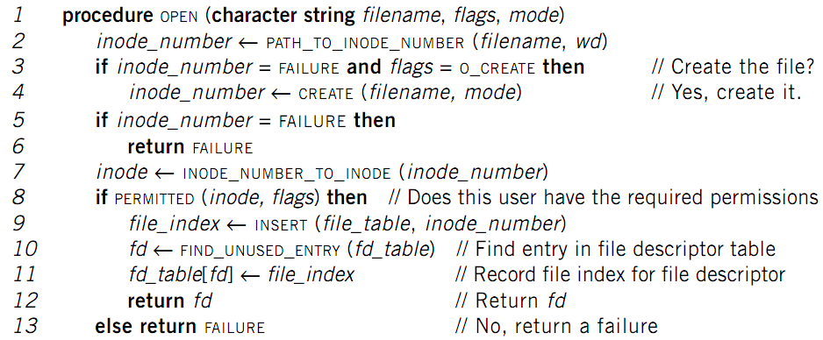
OPEN Implementation

Slide 25
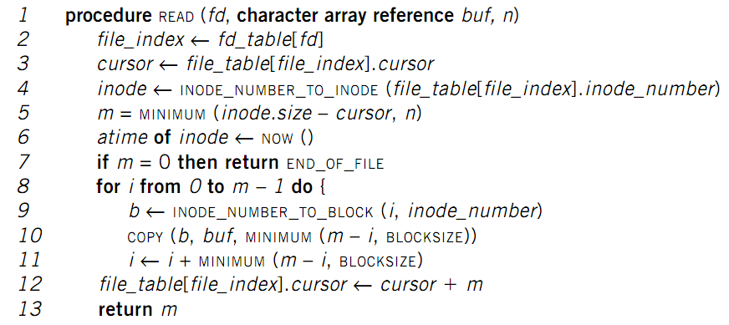
READ Implementation

Slide 26
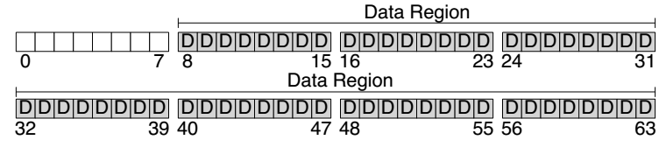
Disk Layout of a Simple File System

Slide 27
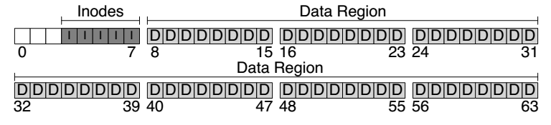
At the Head of a Disk Partition
S
i
d
i: inode free block bitmap
d: data free block bitmap
S: super-block
How many inodes: 80
How many data blocks: 56
Where the inode table begins: block 3
…
A magic number to identify the file system type
The super-block is used when
the file system is mounted

Slide 28
Questions
How many read and write in a OPEN?
How many read and write in a READ?
How many read and write in a CREATION?

Slide 29
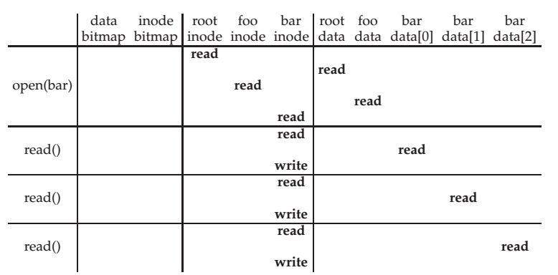
File Open & Read Timeline
open("/foo/bar", O_RDONLY)
Why "write" on bar inode in a read operation? Why no "write" on foo inodes?

Slide 30
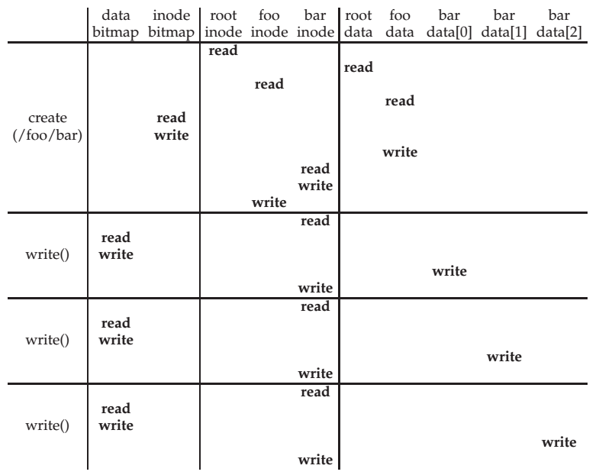
File Creation Timeline

Slide 31
WRITE & CLOSE
WRITE is similar to READ
Allocate new block if necessary
Update inode's size and mtime
CLOSE
Free the entry in the fd_table
Decrease the reference counter in file table
Free the entry in file table if counter is 0
Failures in the middle may cause inconsistency!

Slide 32
Questions
When writing, which order is preferred?
Allocate new blocks, write new data, update size
Allocate new blocks, update size, write new data
Update size, allocate new blocks, write new data

Slide 33
Delete after OPEN but before CLOSE
One process has OPENed a file
Another process removes the last name pointing to the file
Reference counter is now 0
The inode is not freed until the first process calls CLOSE

Slide 34
SYNC
Block cache
Cache of recently used disk blocks
Read from disk if cache miss
Delay the writes for batching
Improve performance
Problem: may cause inconsistency if fail before write
SYNC
Ensure all changes to the file have been written to the storage device

Slide 35


